Slide 1
4
Control Statements:
Part 1

Slide 2
OBJECTIVES
In this chapter you will learn:
To use the if and if...else selection statements to choose among alternative actions.
To use the while repetition statement to execute statements in a program repeatedly.
Counter-controlled repetition and sentinel-controlled repetition.
To use the increment, decrement and assignment operators.

Slide 3
4.1 Introduction
4.2 Algorithms
4.3 Pseudocode
4.4 Control Structures
4.5 if Selection Statement
4.6 if...else Double-Selection Statement
4.7 while Repetition Statement
4.8 Formulating Algorithms: Counter-Controlled Repetition
4.9 Formulating Algorithms: Sentinel-Controlled Repetition
4.10 Formulating Algorithms: Nested Control Statements
4.11 Assignment Operators
4.12 Increment and Decrement Operators
4.13 (Optional) Software Engineering Case Study: Identifying Class Attributes in the ATM System
4.14 Wrap-Up

Slide 4
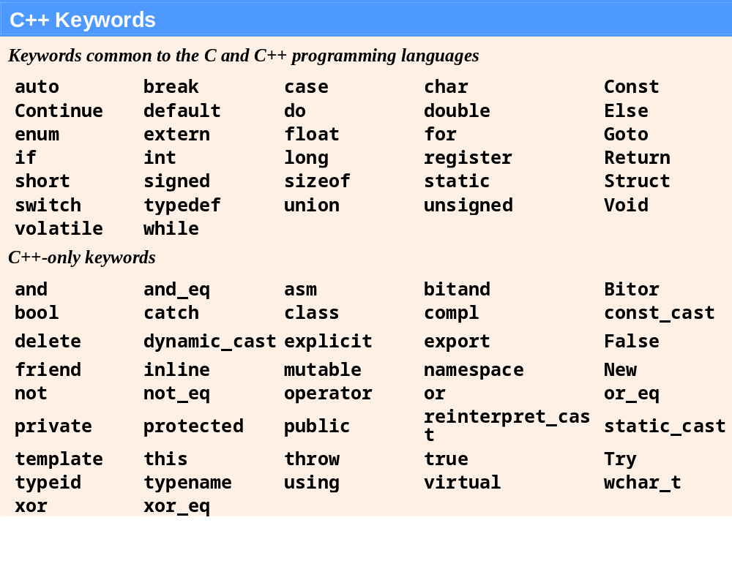
Fig. 4.3 | C++ keywords.

Slide 5
4.6 if…else Double-Selection Statement
if
  Performs action if condition true
if…else
  Performs one action if condition is true, a different action if it is false
Pseudocode
  If student’s grade is greater than or equal to 60
  print “Passed”
  Else
  print “Failed”
C++ code
  if ( grade >= 60 )
  cout << "Passed";
  else
  cout << "Failed";

Slide 6
4.6 if…else Double-Selection Statement (Cont.)
Ternary conditional operator (?:)
  Three arguments (condition, value if true, value if false)
Code could be written:
  cout << ( grade >= 60 ? “Passed” : “Failed” );
Condition
Value if true
Value if false

Slide 7
4.6 if…else Double-Selection Statement (Cont.)
Nested if…else statements
  One inside another, test for multiple cases
  Once a condition met, other statements are skipped
  Example
    If student’s grade is greater than or equal to 90
  Print “A”
  Else
  If student’s grade is greater than or equal to 80
  Print “B”
  Else
  If student’s grade is greater than or equal to 70
  Print “C”
  Else
  If student’s grade is greater than or equal to 60
  Print “D”
  Else
    Print “F”

Slide 8
4.6 if…else Double-Selection Statement (Cont.)
Nested if…else statements (Cont.)
  Written In C++
    if ( studentGrade >= 90 )
    cout << "A";
    else
    if (studentGrade >= 80 )
    cout << "B";
    else
    if (studentGrade >= 70 )
    cout << "C";
    else
    if ( studentGrade >= 60 )
    cout << "D";
    else
    cout << "F";

Slide 9
4.6 if…else Double-Selection Statement (Cont.)
Nested if…else statements (Cont.)
  Written In C++ (indented differently)
    if ( studentGrade >= 90 )
    cout << "A";
    else if (studentGrade >= 80 )
    cout << "B";
    else if (studentGrade >= 70 )
    cout << "C";
    else if ( studentGrade >= 60 )
    cout << "D";
    else
    cout << "F";

Slide 10
4.6 if…else Double-Selection Statement (Cont.)
Dangling-else problem
  Compiler associates else with the immediately preceding if
  Example
    if ( x > 5 )
    if ( y > 5 )
    cout << "x and y are > 5";
    else
    cout << "x is <= 5";
  Compiler interprets as
    if ( x > 5 )
    if ( y > 5 )
    cout << "x and y are > 5";
    else
    cout << "x is <= 5";

Slide 11
4.6 if…else Double-Selection Statement (Cont.)
Dangling-else problem (Cont.)
  Rewrite with braces ({})
    if ( x > 5 )
    {
    if ( y > 5 )
    cout << "x and y are > 5";
    }
    else
    cout << "x is <= 5";
      Braces indicate that the second if statement is in the body of the first and the else is associated with the first if statement

Slide 12
4.6 if…else Double-Selection Statement (Cont.)
Compound statement
  Also called a block
    Set of statements within a pair of braces
    Used to include multiple statements in an if body
  Example
    if ( studentGrade >= 60 )
    cout << "Passed.\n";
    else
    {
    cout << "Failed.\n";
    cout << "You must take this course again.\n";
    }
  Without braces,
  cout << "You must take this course again.\n";
  always executes

Slide 13
4.6 if…else Double-Selection Statement (Cont.)
Empty statement
  A semicolon (;) where a statement would normally be
  Performs no action
  Also called a null statement

Slide 14
4.7 while Repetition Statement
Repetition statement
  Action repeated while some condition remains true
  Pseudocode
    While there are more items on my shopping list
    Purchase next item and cross it off my list
  while loop repeats until condition becomes false
  Example
    int product = 3;
    while ( product <= 100 )
    product = 3 * product;

Slide 15
4.8 Formulating Algorithms: Counter-Controlled Repetition (Cont.)
Uninitialized variables
  Contain “garbage” (or undefined) values
Notes on integer division and truncation
  Integer division
    When dividing two integers
    Performs truncation
      Fractional part of the resulting quotient is lost

Slide 16
4.9 Formulating Algorithms: Sentinel-Controlled Repetition (Cont.)
Floating-point numbers
  A real number with a decimal point
  C++ provides data types float, double and long double
    double numbers can have larger magnitude and finer detail
      Called precision
    Floating-point constant values are treated as double values by default
  Floating-point values are often only approximations

Slide 17
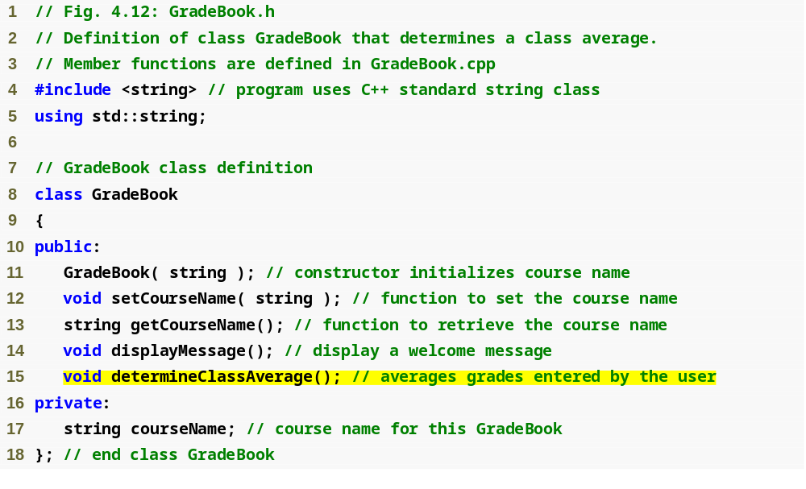
Outline
fig04_12.cpp
(1 of 1)

Slide 18
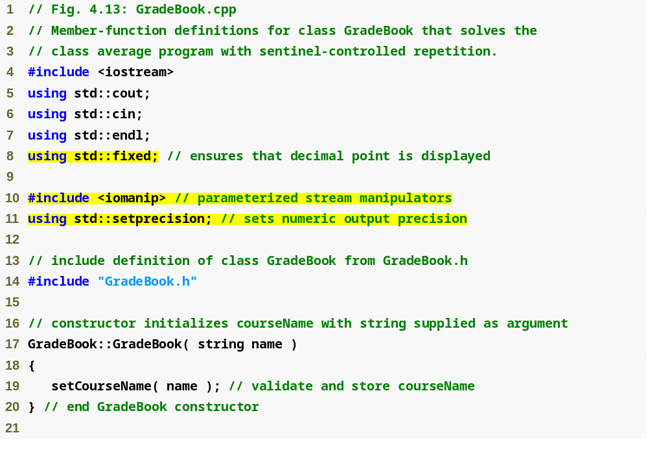
Outline
fixed forces output to print in fixed point format (not scientific notation) and forces trailing zeros and decimal point to print
fig04_13.cpp
(1 of 4)
steprecision stream manipulator (in header <iomanip>) sets numeric output precision

Slide 19
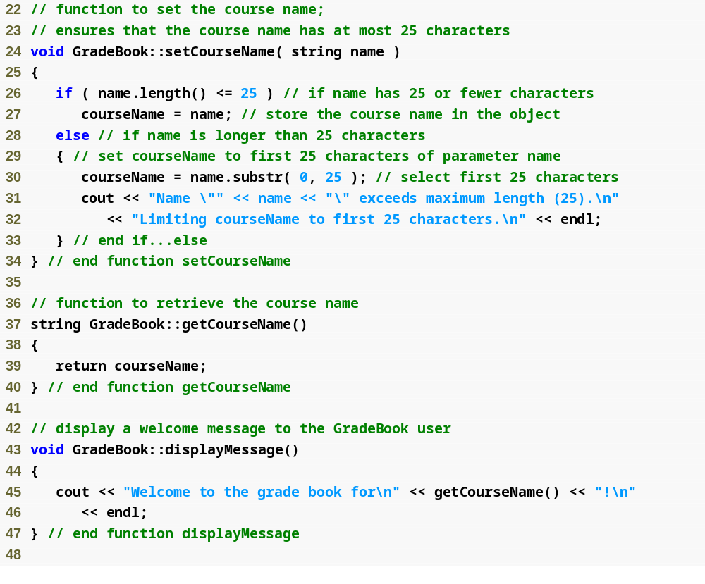
Outline
fig04_13.cpp
(2 of 4)

Slide 20
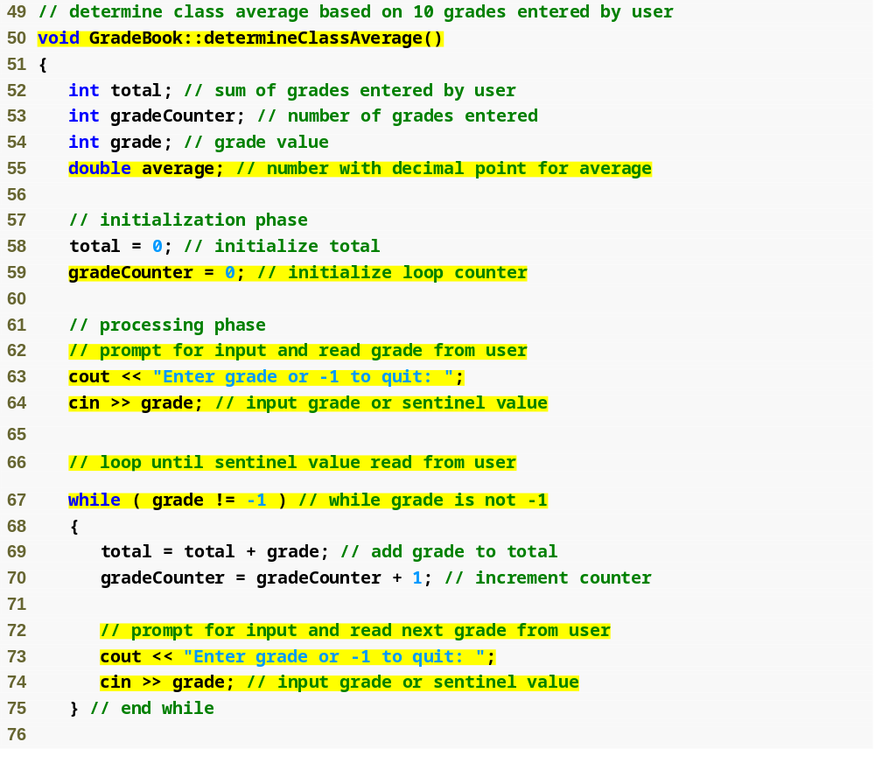
Outline
Function determineClassAverage implements the class average algorithm described by the pseudocode
fig04_13.cpp
(3 of 4)
Declare local int variables total, gradeCounter and grade and double variable average
while loop iterates as long as grade does not equal the sentinel value -1

Slide 21
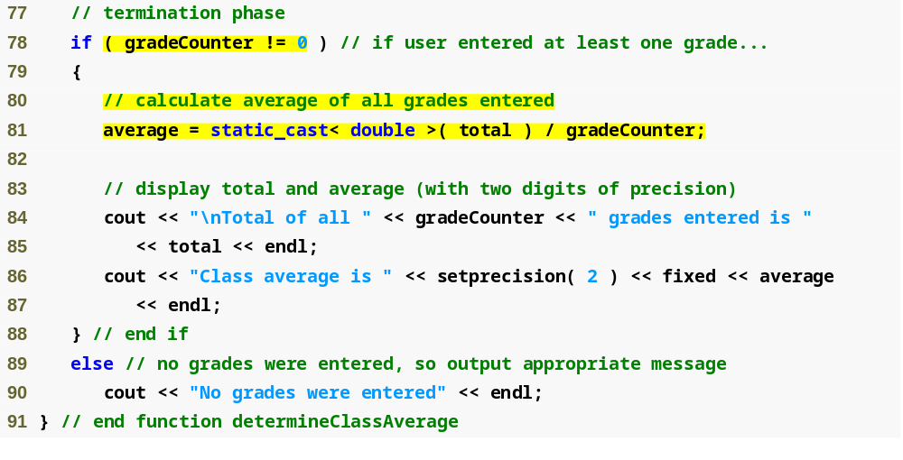
Outline
fig04_13.cpp
(4 of 4)
Calculate average grade using static_cast< double > to perform explicit conversion

Slide 22
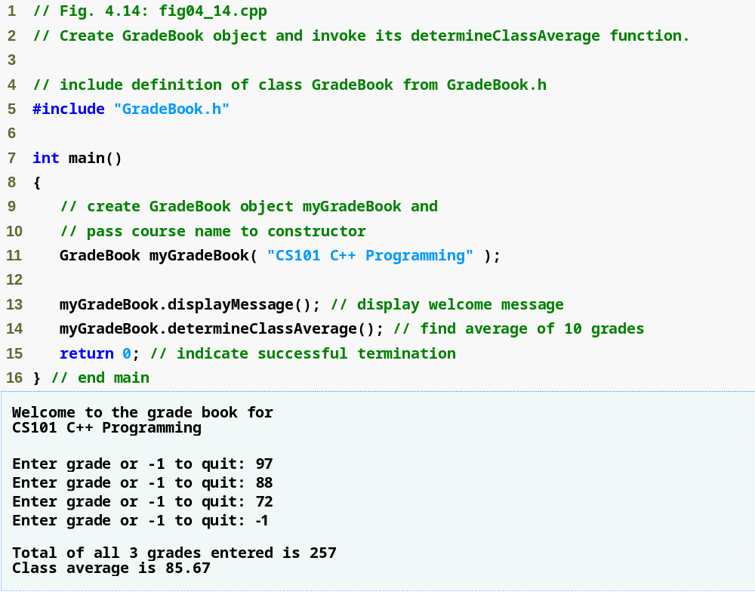
Outline
fig04_14.cpp
(1 of 1)

Slide 23
4.9 Formulating Algorithms: Sentinel-Controlled Repetition (Cont.)
Unary cast operator
  Creates a temporary copy of its operand with a different data type
    Example
      static_cast< double > ( total )
        Creates temporary floating-point copy of total
  Explicit conversion
Promotion
  Converting a value (e.g. int) to another data type (e.g. double) to perform a calculation
  Implicit conversion

Slide 24
4.9 Formulating Algorithms: Sentinel-Controlled Repetition (Cont.)
Formatting floating-point numbers
  Parameterized stream manipulator setprecision
    Specifies number of digits of precision to display to the right of the decimal point
    Default precision is six digits
  Nonparameterized stream manipulator fixed
    Indicates that floating-point values should be output in fixed-point format
      As opposed to scientific notation (3.1 × 10³)
  Stream manipulator showpoint
    Forces decimal point to display

Slide 25
4.10 Formulating Algorithms: Nested Control Statement
Problem statement
A college offers a course that prepares students for the state licensing exam for real estate brokers. Last year, ten of the students who completed this course took the exam. The college wants to know how well its students did on the exam. You have been asked to write a program to summarize the results. You have been given a list of these 10 students. Next to each name is written a 1 if the student passed the exam or a 2 if the student failed.
Your program should analyze the results of the exam as follows:
1. Input each test result (i.e., a 1 or a 2). Display the prompting message
“Enter result” each time the program requests another test result.
2. Count the number of test results of each type.
3. Display a summary of the test results indicating the number of
students who passed and the number who failed.
4. If more than eight students passed the exam, print the message “Raise
tuition.”

Slide 26
4.10 Formulating Algorithms: Nested Control Statement (Cont.)
Notice that
  Program processes 10 results
    Fixed number, use counter-controlled loop
  Each test result is 1 or 2
    If not 1, assume 2
  Two counters can be used
    One counts number that passed
    Another counts number that failed
  Must decide whether more than eight students passed

Slide 27
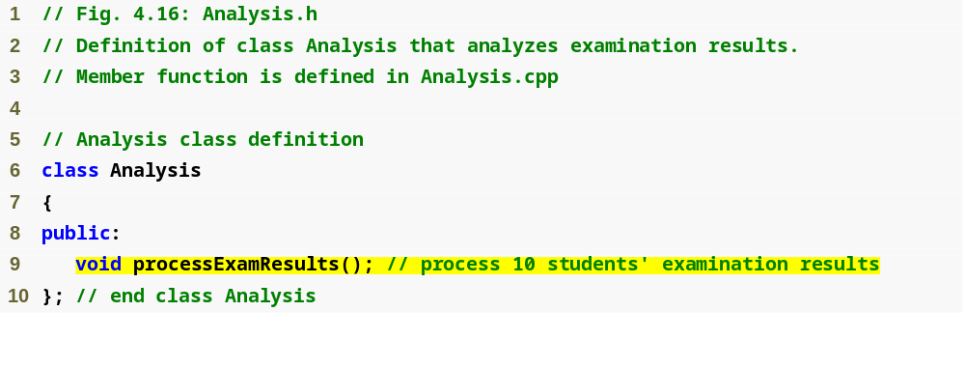
Outline
fig04_16.cpp
(1 of 1)

Slide 28
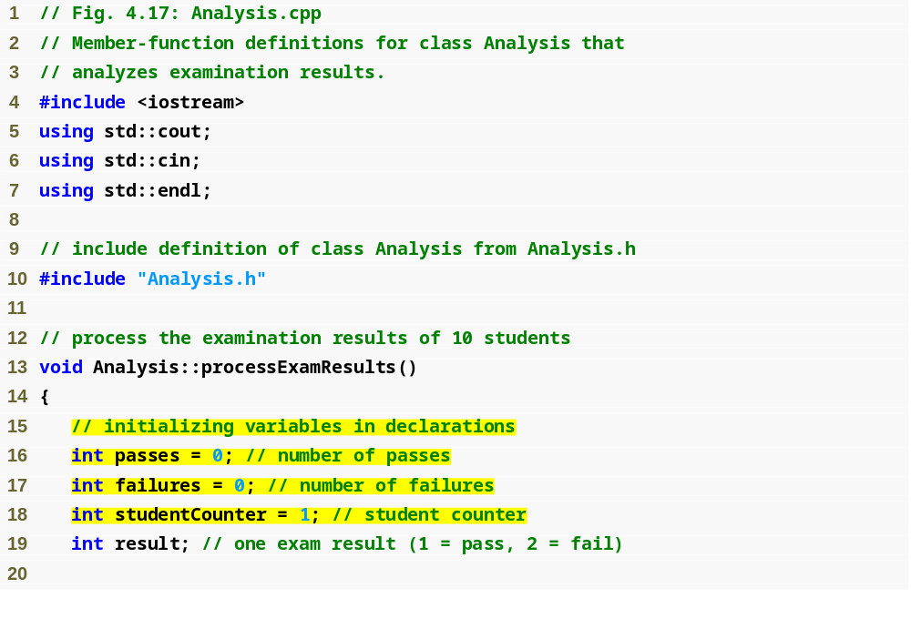
Outline
fig04_17.cpp
(1 of 2)
Declare function processExamResults’s local variables

Slide 29
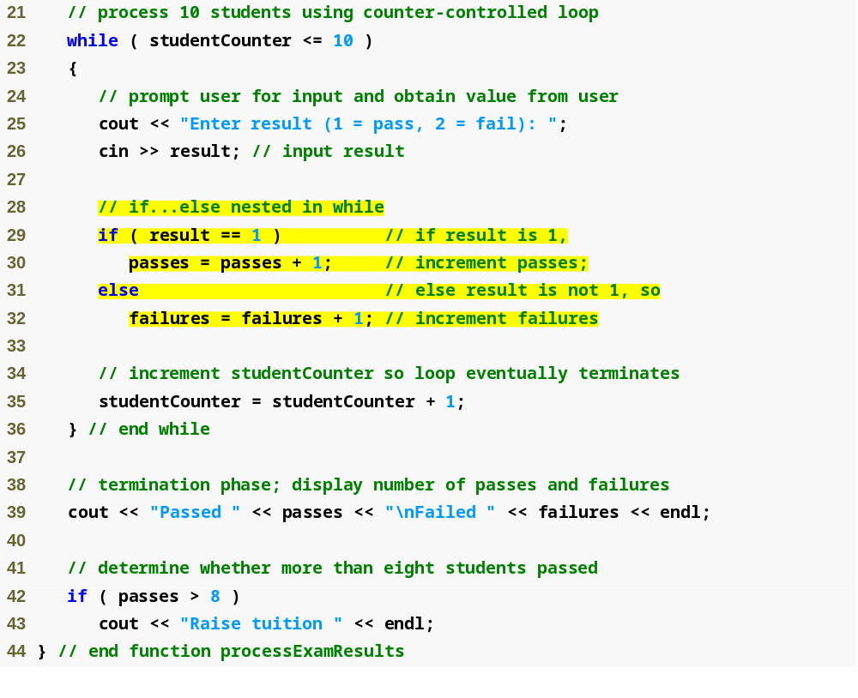
Outline
fig04_17.cpp
(2 of 2)
Determine whether this student passed or failed, and increment the appropriate variable
Determine whether more than eight students passed

Slide 30
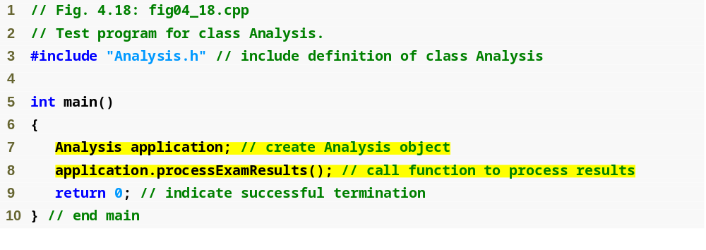
Outline
fig04_18.cpp
(1 of 2)

Slide 31
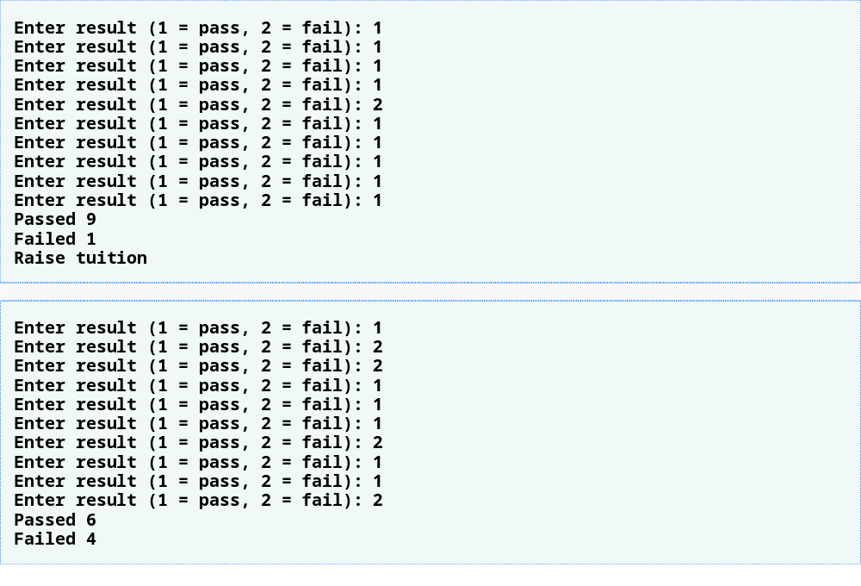
Outline
fig04_18.cpp
(2 of 2)
More than eight students passed the exam

Slide 32
4.11 Assignment Operators
Assignment expression abbreviations
  Addition assignment operator
    Example
      c = c + 3; abbreviates to c += 3;
Statements of the form
    variable = variable operator expression;
  can be rewritten as
    variable operator= expression;
Other assignment operators
  d -= 4 (d = d - 4)
  e *= 5 (e = e * 5)
  f /= 3 (f = f / 3)
  g %= 9 (g = g % 9)

Slide 33
4.12 Increment and Decrement Operators
Increment operator ++
  Increments variable by one
    Example
      c++
Decrement operator --
  Decrement variable by one
    Example
      c--

Slide 34
4.12 Increment and Decrement Operators (Cont.)
Preincrement
  When the operator is used before the variable (++c or --c)
  Variable is changed, then the expression it is in is evaluated using the new value
Postincrement
  When the operator is used after the variable (c++ or c--)
  Expression the variable is in executes using the old value, then the variable is changed

Slide 35
4.12 Increment and Decrement Operators (Cont.)
If c = 5, then
  cout << ++c;
    c is changed to 6
    Then prints out 6
  cout << c++;
    Prints out 5 (cout is executed before the increment)
    c then becomes 6

Slide 36
4.12 Increment and Decrement Operators (Cont.)
When variable is not in an expression
  Preincrementing and postincrementing have same effect
    Example
      ++c;
      cout << c;
      and
      c++;
      cout << c;
      are the same

